Slide 1

SITEMAPS
Sitemaps are a way of mapping out the structure and organization of pages,
and content in your website. There are two main types of sitemaps, visual, and XML.
The latter being used by search engines to crawl through the website and index it for search.

Slide 2
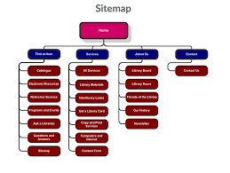
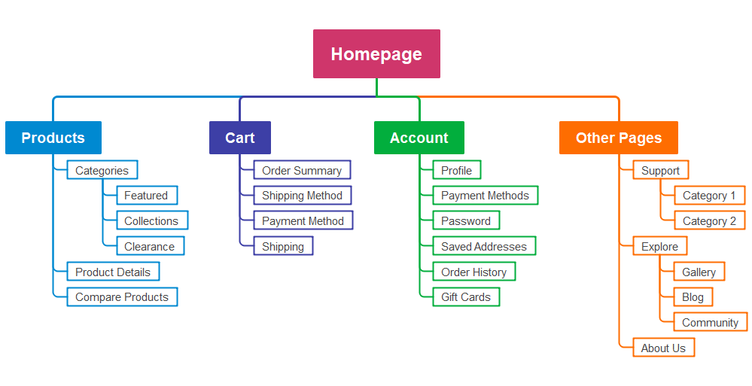
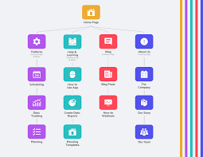
EXAMPLES OF SITEMAPS

